Slide 3
Living in the goodness of God
The God of my Valleys

Slide 5
The Lord is my shepherd; I have all that I need.
He lets me rest in green meadows;
he leads me beside peaceful streams.
He renews my strength.
He guides me along right paths,
bringing honor to his name. Even when I walk through the darkest valley,
I will not be afraid, for you are close beside me.
Psalm 23:1-4 New Living translation

Slide 6
Psalm 23

Slide 7
After their defeat, Ben-hadad’s officers said to him, “The Israelite gods are gods of the hills;
that is why they won.
But we can beat them easily on the plains.
1 Kings 20:23

Slide 8
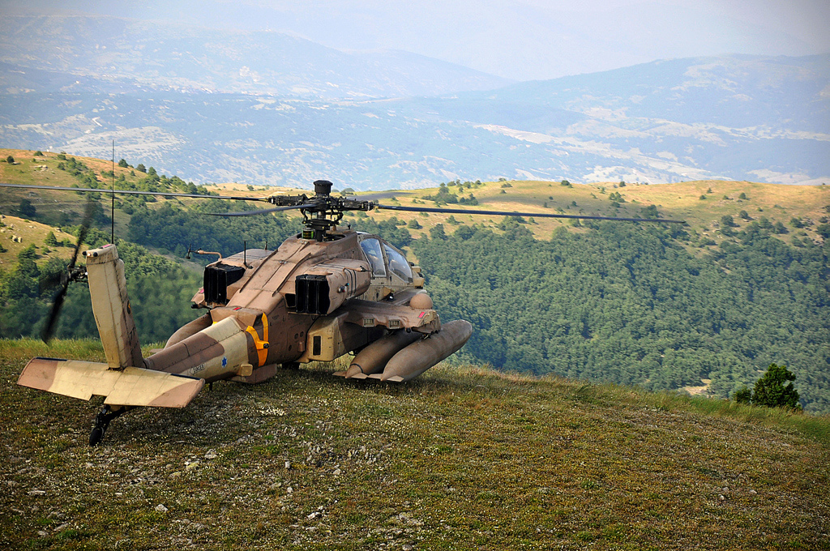

Slide 9
Then the man of God went to the king of Israel and said, “This is what the Lord says: The Arameans have said, ‘The Lord is a god of the hills and not of the plains.’
So I will defeat this vast army for you.
Then you will know that I am the Lord.”
1 Kings 20:28

Slide 10
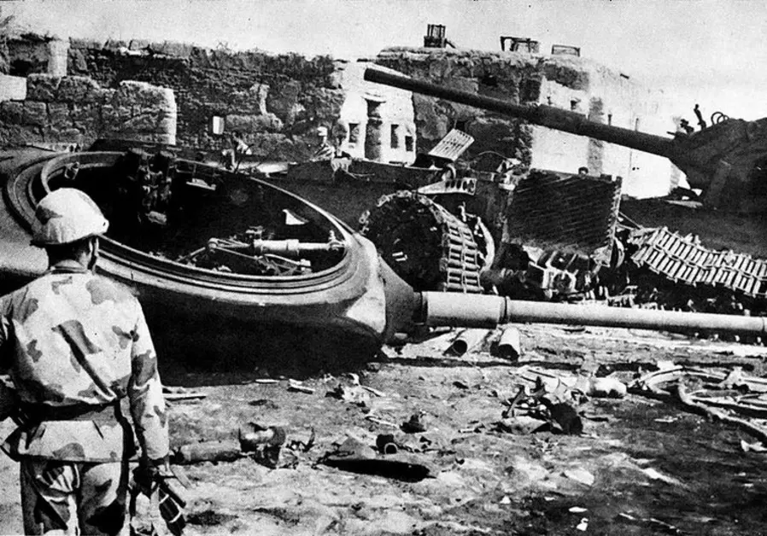

Slide 11
Psalm 23

Slide 12
What We Know About Valleys

Slide 13
Valleys are Inevitable
Dear friends, don’t be surprised at the fiery trials you are going through, as if something strange were happening to you. 1 peter 4:12

Slide 14
Valleys are Impartial
Here on earth you will have many trials and sorrows. But take heart, because I have overcome the world.”
John 16:33

Slide 15
Valleys are Unpredictable
“Don't ever brag about tomorrow, since you don't know what the day will bring forth.”
proverbs 27:1

Slide 16
Psalm 23

Slide 17
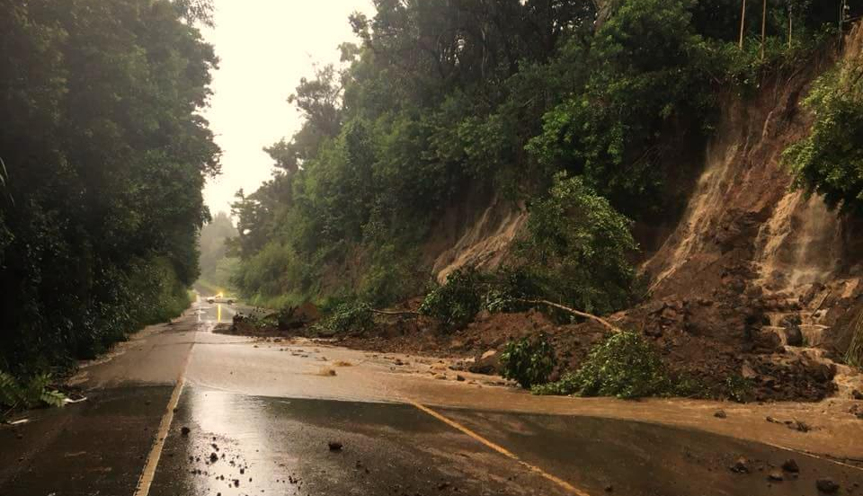
What Kinds of Valleys to Expect

Slide 18
Valley of Failure
…kings joined forces in Siddim Valley …the valley of the Dead Sea was filled with tar pits. And as the army of the kings of Sodom and Gomorrah fled, some fell into the tar pits, while the rest escaped into the mountains.
Genesis 14: 3,10

Slide 21
Valley of Fear
When they came to the valley of Eshcol, they cut down a branch with a single cluster of grapes so large that it took two of them to carry it on a pole between them!
Numbers 13:23

Slide 22
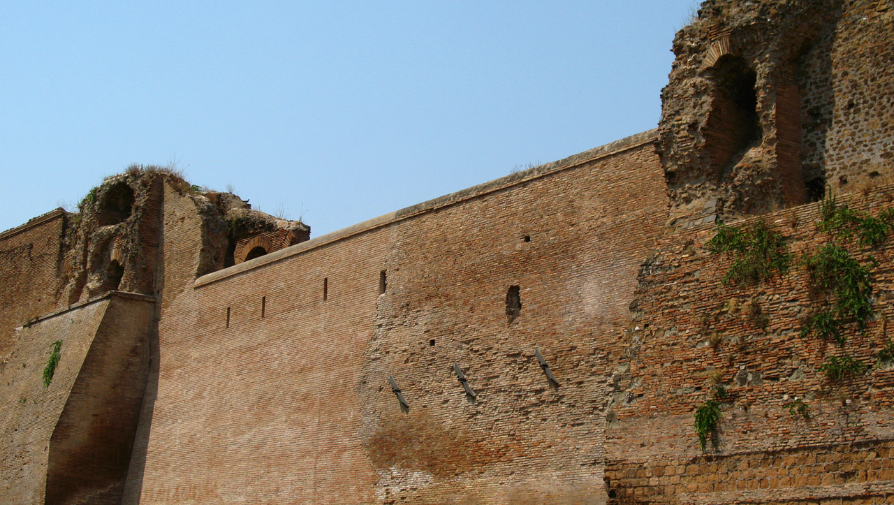
But the people living there are powerful, and their towns are large and fortified.
We even saw giants there!
Numbers 13:28

Slide 24
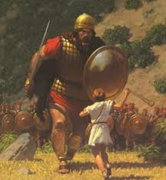
Valley of Conflict
Saul countered by gathering his Israelite troops near the valley of Elah. So the Philistines and Israelites faced each other on opposite hills, with the valley between them.
1 Samuel 17:2-3

Slide 26
Valley of Grief
Blessed are those whose strength is in you,
in whose heart are the highways to Zion.
As they go through the Valley of Baca
they make it a place of springs;
the early rain also covers it with pools.
Psalm 84: 5-6

Slide 29
What to remember in a
Valley

Slide 30
You are not alone
Even when I walk
through the darkest valley,
I will not be afraid,
for you are close beside me. (for thou art with me) KJV
Psalm 23:4

Slide 31
Jehovah-Shammah
“The Lord is There”

Slide 33
God will use it for good
We can rejoice, too, when we run into problems and trials, for we know that they help us develop endurance. And endurance develops strength of character, and character strengthens our confident hope of salvation. And this hope will not lead to disappointment. For we know how dearly God loves us.
ROMANS 5:3-5

Slide 34
“I will transform the Valley of Trouble into a Gateway of Hope!”
Hosea 2:15

Slide 35
We think you ought to know, dear brothers and sisters, about the trouble we went through in the province of Asia. We were crushed and overwhelmed beyond our ability to endure, and we thought we would never live through it. In fact, we expected to die. But as a result, we stopped relying on ourselves and learned to rely only on God.
2 Corinthians 1: 8-9

Slide 37
The valley is temporary
Even when I walk through the darkest valley,
I will not be afraid,
for you are close beside me
Psalm 23:4

Slide 38
The way to a mountaintop
is often through a valley.

Slide 39
Psalm 23

