Slide 2
MEALS WITH JESUS
LUKE 5: Jesus feasts with Levi and other “sinners” LUKE 7: Jesus is anointed at a Pharisee’s house LUKE 9: Jesus feeds the five thousand LUKE 10: Jesus eats at home of Mary and Martha LUKE 11: Jesus condemns the Pharisees at dinner LUKE 14: Jesus discusses who to invite to a party LUKE 19: Jesus and dinner at Zaccheus’ house LUKE 22: Jesus’ Last Supper with his disciples LUKE 24: Jesus has dinner in Emmaus LUKE 24: Jesus cooks fish for disciples on lakeshore

Slide 3
THREE TAKEAWAYS
FROM THE DINNER WITH SIMON
One of the Pharisees asked Jesus to have dinner with him, so Jesus went to his home and sat down to eat.
LUKE 7:36

Slide 5
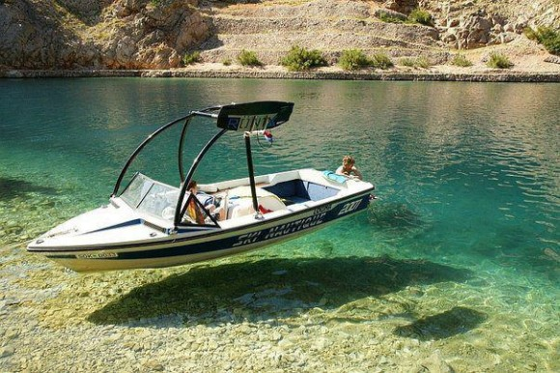

Slide 7
PHARISEES
6,000 of them
interpret the Mosaic Law.
great influence
gave equal authority to their additional laws, as they gave to the Scriptures.

Slide 9
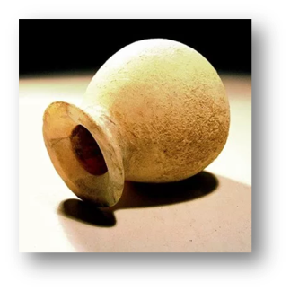
³⁶ One of the Pharisees asked Jesus to have dinner with him, so Jesus went to his home and sat down to eat. ³⁷ When a certain immoral woman from that city heard he was eating there, she brought a beautiful alabaster jar filled with expensive perfume. ³⁸ Then she knelt behind him at his feet, weeping. Her tears fell on his feet, and she wiped them off with her hair. Then she kept kissing his feet and putting perfume on them.
LUKE 7:36-38

Slide 10
³⁹ When the Pharisee who had invited him saw this, he said to himself, “If this man were a prophet, he would know what kind of woman is touching him. She’s a sinner!”
⁴⁰ Then Jesus answered his thoughts. “Simon,” he said to the Pharisee, “I have something to say to you.”
“Go ahead, Teacher,” Simon replied.
LUKE 7:39-40

Slide 11
⁴¹ Then Jesus told him this story: “A man loaned money to two people—500 pieces of silver to one and 50 pieces to the other. ⁴² But neither of them could repay him, so he kindly forgave them both, canceling their debts. Who do you suppose loved him more after that?”
LUKE 7:41-42

Slide 13
1
AN INSURMOUNTABLE
SPIRITUAL DEBT
Who do you suppose loved him more after that?”
⁴³ Simon answered, “I suppose the one for whom he canceled the larger debt.”
“That’s right,” Jesus said.
LUKE 7:42-43

Slide 14
"It's too easy to confuse good behavior
with a changed heart."

Slide 15
TOTAL DEPRAVITY
every part of man—his mind, will, emotions and flesh—have been corrupted by sin.
“We are not sinners because we sin,
we sin because we are sinners.”
—R.C. SPROUL

Slide 16
TOTAL DEPRAVITY
No one is righteous—not even one. ¹¹ No one is truly wise; no one is seeking God. ¹² All have turned away; all have become useless. No one does good, not a single one.”
—ROMANS 3:10-12

Slide 18
2
AN INCREDIBLE
DISPLAY OF GRATITUDE
⁴⁴ Then he turned to the woman and said to Simon, “Look at this woman kneeling here. When I entered your home, you didn’t offer me water to wash the dust from my feet, but she has washed them with her tears and wiped them with her hair. ⁴⁵ You didn’t greet me with a kiss, but from the time I first came in, she has not stopped kissing my feet. ⁴⁶ You neglected the courtesy of olive oil to anoint my head, but she has anointed my feet with rare perfume.
LUKE 7:44-46

Slide 20
https://www.youtube.com/watch?v=mFQeWPQzc_M

Slide 22
3
AN INDISPUTABLE DECLARATION OF DIVINITY
⁴⁷ “I tell you, her sins—and they are many—have been forgiven, so she has shown me much love. But a person who is forgiven little shows only little love.” ⁴⁸ Then Jesus said to the woman, “Your sins are forgiven.” ⁴⁹ The men at the table said among themselves, “Who is this man, that he goes around forgiving sins?” ⁵⁰ And Jesus said to the woman, “Your faith has saved you; go in peace.”
LUKE 7:47-50

Slide 24
We need to think about how much God has forgiven us, shake our apathy,
and love Him fervently.

Slide 25
1. Stay outside in the front yard longer while watering the yard
2. Walk your dog regularly around the same time in your neighborhood
3. Invite neighbors over for dinner or game night
4. Attend and participate in HOA functions
5. Attend the parties invited to by neighbors
6 Host a coffee and dessert night
7. Organize a carpool for your neighborhood to help save gas
8. Volunteer to coach a local little league sports team
9. Have a front yard ice cream party in the summer

